Slide 1

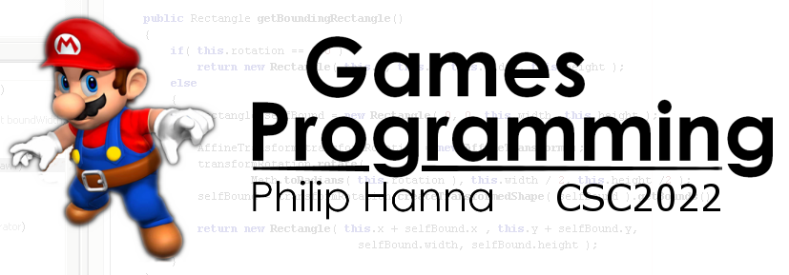
Optimisation
Part 3 – Storage

Slide 2

Stack or Heap

Slide 3

Instance created on the heap.
Allocating and deallocating heap memory is a relatively expensive operation (using the new and delete keywords).
If possible allocating objects/data on the stack permits faster assignment/release of memory.
1 | void foo()
2 | {
3 | SomeCass *ptrObj = new SomeClass();
4 | // …
5 | delete *ptrObj;
6 | }
Instance created on the heap. No need to allocate and then free heap memory.
1 | void foo()
2 | {
3 | SomeCass someClass;
4 | // …
5 | }
Notes:
Allocating and deallocating heap memory is a relatively expensive operation (using the new and delete keywords).
If possible (and it’s not always possible) allocating classes/objects on the stack permit faster allocation/release of memory, consider:
void foo()
{
SomeClass *ptrClass = new SomeClass();
...
delete ptrClass;
}
A better performance choice would be to define a local object of type X:
void f00()
{
SomeClass someClass;
...
}
The later avoids the potentially higher cost to locating a free segment of memory on the heap alongside the process of freeing that memory from the heap.

Slide 4

More flexible but slower.
This aspect also applies to the choice of embedding an object within a containing object or using a linked pointer.
In all of this, there is a balance to be struck between performance vs. design flexibility.
1 | class Foo()
2 | {
3 | public:
4 | Foo() : ptrObj(new SomeClass) {}
5 | ~Foo() { delete ptrObj; }
6
7 | private:
8 | SomeClass *ptrObj;
9 | }
Less flexible but faster.
1 | class Foo()
2 | {
3 | public:
4 | Foo() {}
5
6 | private:
7 | SomeClass someObj;
8 | }
Notes:
This aspect also applies to the choice of embedded an object within a containing object or using a linked pointer.
The cost of creating the object is significantly increased by the overhead of calling new() in the constructor and delete() in the destructor. Embedding the object removes this cost – but is at the expensive of design flexibility – the member cannot be used polymorphically any more.

Slide 5
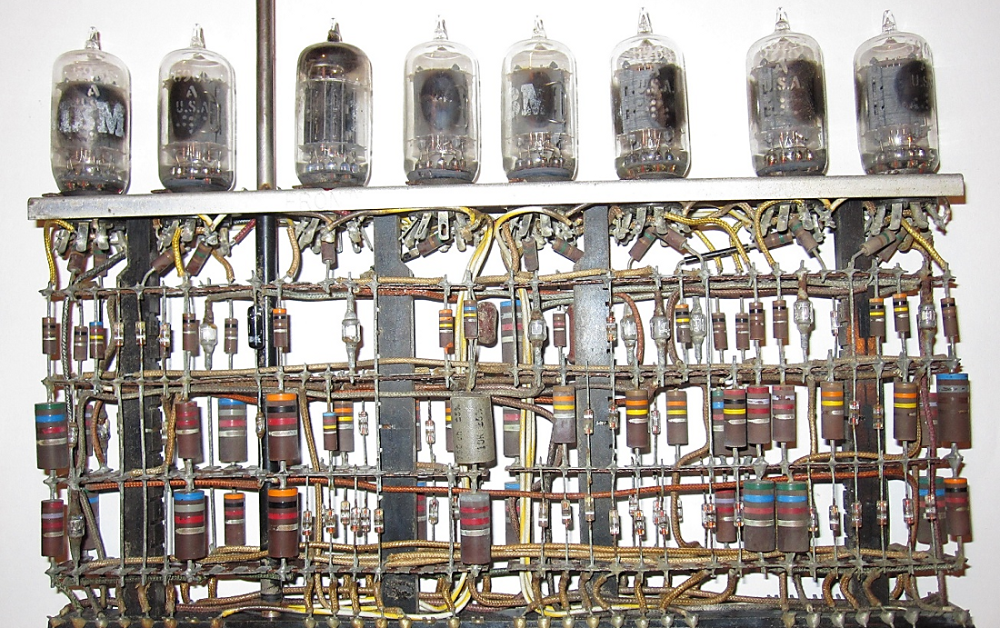
Memory Management

Slide 6
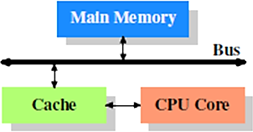
In the early 90s the frequency of CPUs (then measured in MHz) started to notably outpace the speed of (affordable) memory.
To compensate, CPUs were paired with a small amount of very fast (expensive) memory. The cache operates by holding data that is likely to be required by the CPU.
Understanding, facilitating and exploiting the temporal and spatial locality of code / data is key to making effective use of caches.

Slide 7
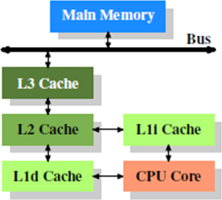
The cache structure within a modern CPU is somewhat more complicated. Typically a number of levels of cache are used (increasing in size and decreasing in speed).
Instructions and data may also be stored within separate caches to improve overall caching efficiency. Also multi core CPUs may have individual and/or shared cache access.
Register
L1 Cache
L2 Cache
L3 Cache
Main Memory
1 cycle
~4 cycles
~10 cycles
~75 cycles
~200-500 cycles
Notes:
The typically cache structure within a modern CPU is somewhat more complicated. Typically a number of levels of caches are used (increasing in size and decreasing in speed). Instructions and data may also be stored within separate caches to improve overall caching efficiency. Also multi core CPUs may have individual and/or shared cache access.

Slide 8


For large data sets it is useful to consider how the data will be accessed and to rearrange data structures to ensure frequently accessed data is grouped together in memory. For example:
1 | struct DataRecord
2 | {
3 | float average, sd;
4 | float data[100];
5 | };
More efficiently arranged data:
1 | void processLotsOfData(DataRecord* ptrData)
2 | {
3 | float average = 0.0f;
4 | for(int i=0; i<numRecords; i++)
5 | average += ptrData[i].average;
6 | // Likely lots of cache misses
7 | average /= numRecords;
9 | }
1 | struct DataStats
2 | {
3 | float average, sd;
4 | };
1 | struct RawData
2 | {
3 | float data[100];
4 | };
Notes:
For large data sets it is useful to consider how the data will be accessed and to rearrange data structures to ensure frequently accessed data is grouped together in memory.
For example:
struct DataRecord
{
float average, sd;
float data[100];
};
void ProcessLotsOfData(DataRecord* ptrRecords)
{
float average = 0.0f;
for( int i = 0; i < N; i++ )
average += ptrData[i].average;
// Like lots of cache misses
average /= N;
}
It would be better to split the data as such:
struct DataStats
{
float average, sd;
};
struct RawData
{
float data[100];
};

Slide 9

Temporaries

Slide 10
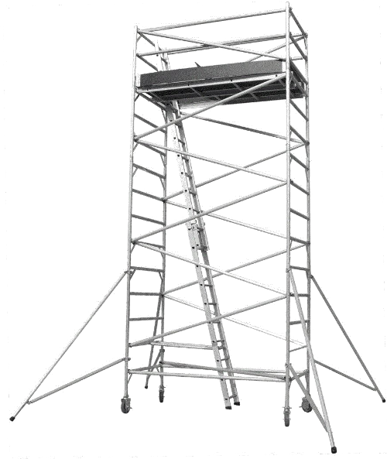
Temporaries are data items that are silently generated by the compiler, used to perform or facilitate some operation and then silently removed.
It is important to understand the conditions under which temporary data items (and in particular class instances) are created.
Notes:
Temporaries are data items that are silently generated by the compiler, used to perform or facilitate some operation and then silently removed.
It is important to understand the conditions under which temporary data items (and in particular class instances) are created.

Slide 11

Object Creation
Consider:
1 | class Rational
2 | {
3 | friend Rational operator+(const Rational& lhs,
4 | const Rational& rhs);
5 | public:
6 | Rational(int n=0, int d=1) : num(n), den(d) {}
7
8 | private:
9 | int num; // Numerator
10 | int den; // Denominator
11 | }
1 | Rational r1(10); // Definitely no temporary object
2
3 | Rational r2 = Rational(100); // Depending on the
4 | Rational r3 = 100; // compiler, both these might
5 | // result in temporary objects.
Most good compilers will optimize away the temporary.
Notes:
Consider:
class Rational
{
friend Rational operator+(const Rational&, const Rational&);
public:
Rational (int n = 0, int d = 1 ) : num(n), den(d) {}
private:
int num; // Numerator
int den; // Denominator
};
Rational r1(10);
This form of initialization is guaranteed, across compiler implementations, not to generate a temporary object.
Whilst, depending upon the compiler, the following may result in temporary object creation.
Rational r2 = Rational(100);
Rational r3 = 100;

Slide 12


Type Mismatch
The compiler will merrily determine if it can convert a specified type into an expected type. This can involve temporary object creation, e.g.:
The compiler checks for an assignment overload accepting an int. Failing this, it checks for a constructor accepting an int. Finding one, it constructs an instance and invokes the copy assignment constructor.
1 | Rational r;
2 | r = 100;
1 | Rational _tmp;
2 | _tmp.Rational(100,1); // Construct tmp
3 | r.operator=(_tmp); // Assign tmp to r
4 | tmp.~Rational(); // Destroy temporary
Notes:
Anytime a variable (object) of a given type is expected and some other type is provided the compiler will determine if it can convert the specified type into the expected type. This can involve temporary object creation, e.g.:
Rational r;
r = 100;
The compiler checks to see if the class provides an assignment operation accepting an int. Failing this, it checks for a constructor accepting an int. After finding one, it constructed an class instance and invokes the copy assignment constructor.
Rational _temp;
_temp.Rational(100,1); // Construct temporary
r.operator=(_temp); // Assign temporary to r
temp.~Rational(); // Destroy the temporary

Slide 13

Type Mismatch
Aside: C++11 permits you to forbid such conversion using the explicit keyword, e.g.:
The explicit keyword tells the compiler that you oppose usage of this constructor as a conversion
constructor.
1 | explicit Rational(int n=0, int d=1) : num(n), den(d) {}
Notes:
Aside: C++11 permits you to forbid such conversion using the explicit keyword, e.g.:
explicit Rational (int n = 0, int d = 1 ) : num(n), den(d) {}
The explicit keyword tells the compiler that you oppose usage of this constructor as a conversion
constructor.

Slide 14

Return by Value
Any function that returns an object may also result in the creation of a temporary value.
Consider the string overloaded + operator for concatenating two strings:
1 | string s1 = “First";
2 | string s2 = “Second";
3 | string s3;
5 | s3 = s1 + s2; // s3 = “FirstSecond”
The statement: s3 = s1 + s2; results in the following:
Invocation of operator+(const string &, const string &)
Construction of a temporary r-value holding the concatenation
Invocation of the string::operator= to copy the concatenation
Destruction of the temporary (r-value) object.
Notes:
Any function that returns an object may also return in the creation of a temporary value.
Consider the string overloaded + operator for concatenating two strings:
string s1 = "First";
string s2 = "Second";
string s3;
s3 = s1 + s2; // s3 <- "FirstSecond"
The statement: s3 = s1 + s2; results in the following
Invocation of operator+(const string &, const string &)
Construction of a temporary r-value holding the concatenation
Invocation of the string::operator= to copy the concatenation
Destruction of the temporary (r-value) object.

Slide 15

Return by Value
Why does: s3 = s1 + s2 generate a temporary in the first place?
The reason for this is that the string::operator=() operator gets to determine how the object is assigned and it requires an object as its input (temporary or otherwise).
However, if s3 is a brand new string that has yet to be constructed, then the compiler can use s3 as the temporary object.
This is known as the return value optimisation.
Notes:
Why does: s3 = s1 + s2; generate a temporary?
The reason for this is the string::operator=() operator is responsible for controlling how the object gets to be assigned, hence, it requires a temporary object as it’s input.
However, if s3 is a brand new string that has yet to be constructed, then the compiler use s3 as temporary object. This is known as the return value optimisation:

Slide 16

Key takeaways:
Minimize memory management calls.
Write cache-friendly code.

